Slide 1
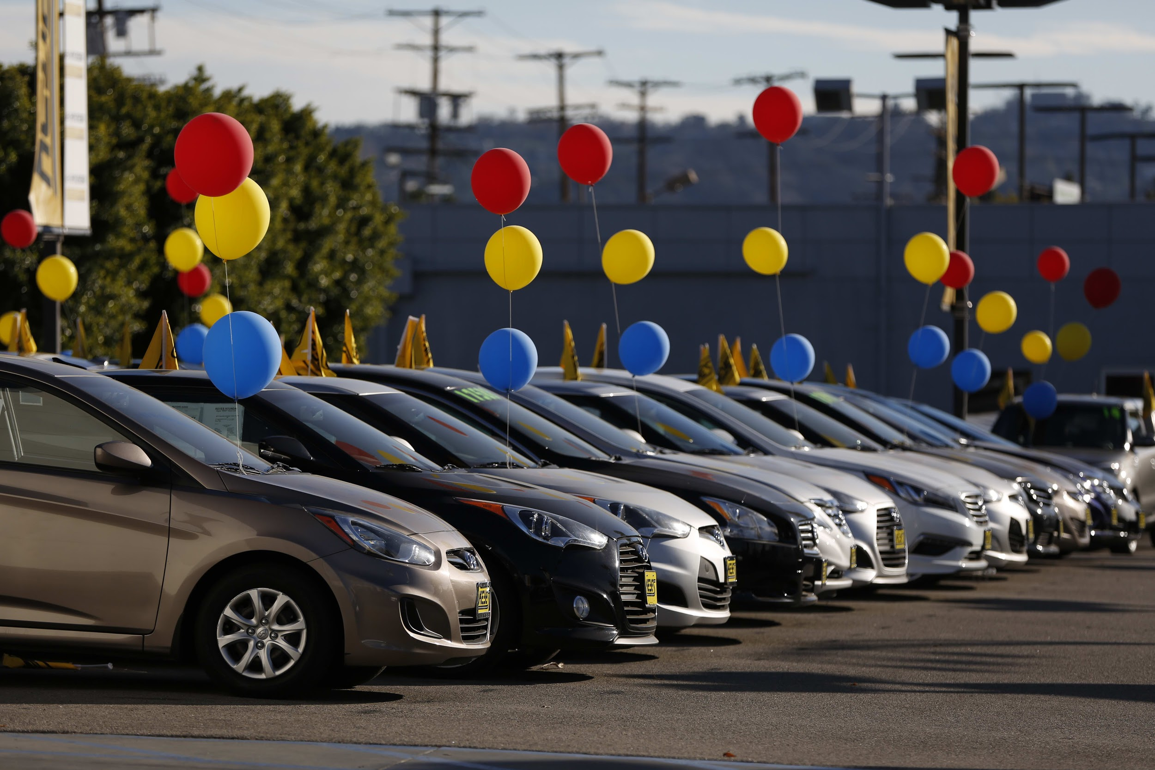
Car Sales EDA

Slide 2
Introduction
Finding patterns in Data
Determining relationships in Data
Checking of assumptions
Preliminary selection of appropriate models
Detection of mistakes

Slide 3
EdA Essentials
Problem Statement
Importing Packages
Shortlisting Data and Columns
Purification of Data
Analysis (Finding patterns in Data)
Univariate
Bivariate
Multivariate
Uncover insights (Answer questions in the data)
Conclude (Story Telling)
Actionable Insights

Slide 4
Problem Statement
Which brand of the cars sold most?
What all the factors are affecting to the car buyers?
What all features most likely for high profile buyers?
Got this data from INSAID to prepare Exploratory Data Analysis (EDA) with basic use of Pandas which includes cleaning, munging, combining, reshaping, slicing, dicing and transforming data for analysis purpose.

Slide 5
Importing Packages
Numpy - Implementing multi-dimensional array and matrices.
Pandas - For data manipulation and analysis.
Pandas Profiling - Providing analysis like type, unique values, missing values, quantile statistics, mean, mode, median, standard deviation, sum, skewness, frequent values, histograms, correlation between variables, count, heatmap visualization, etc.
Matplotlib - Plotting library for Python programming language and it's numerical mathematics extension NumPy.
Seaborn - Provides a high level interface for drawing attractive and informative statistical graphics.

Slide 6
Initial observations
This dataset has 9576 rows and 10 columns.
Summary of data types in this dataset:
Numeric: price (Float), Mileage (Integer), engV (Float), Year (Integer)
Boolean: registration
Object: Everything else
The following variables have null and zero values that may need to addressed.
Car has a high cardinality 87 distinct values.
Drive has 511 (5.3%) missing values.
Eng Volume has 434 (4.5%) missing values.
Mileage has 348 (3.6%) zeros.
Model has a high cardinality with 888 distinct values.
Price has 267 (2.4%) zeros.

Slide 7
Final observations
Price & Mileage: Remove outliers as the columns have outlier as 0 and it is too low to be real value.
Drive & engV: Replaced the null values with the column mean value.
Car column looks good as we can expect 87 distinct values for Brand.
Model seems not useful for analysis and need to remove or ignore this column.
This dataset has 201 duplicate rows, which was removed here and now 9375 unique rows are present in dataset.

Slide 8
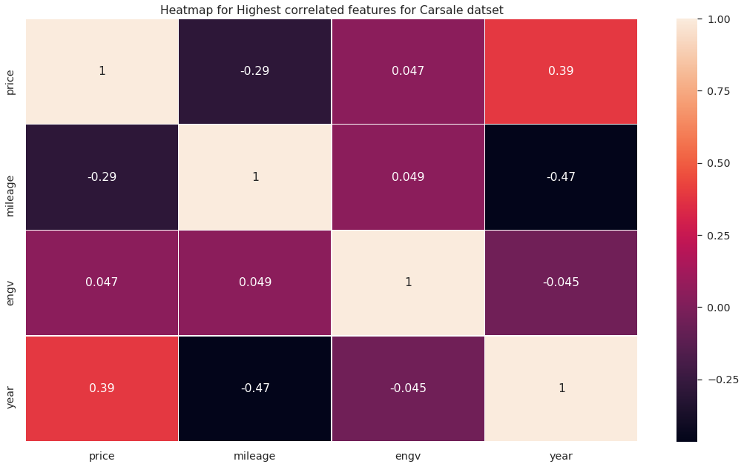
Heatmap for Highest correlated features for Car Sale data set (Continued...)

Slide 9
price and production year variables have strong positive correlation, i.e. latest production year cars have high price and older production year cars have lower price.
price and engine volume (engV) have mild positive correlation.
engine volume (engV) and mileage also have some mild positive correlation, generally engine volume and mileage do not have positive correlation, but in our data most of the cars have engine volume in between 1.5 CC to 2.5 CC, due to that mileage and engine volume have mild positive correlation.
production year and mileage variables have strong negative correlation, i.e. latest production year cars have high mileage and older production year cars have low mileage.
price and mileage have negative correlation, i.e. lower price cars have higher mileage and higher price cars have lower mileage.
production year and engine volume (engV) also have some negative correlation.

Slide 10
Univariate Analysis

Slide 11
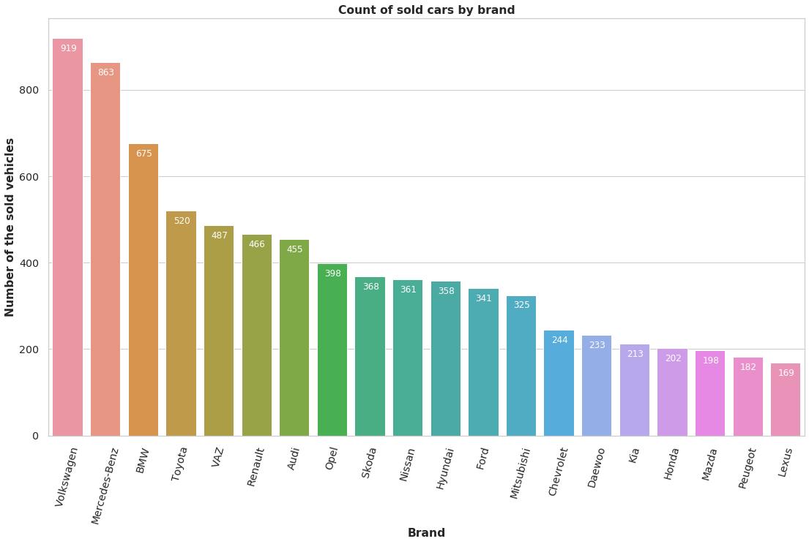
Which brand of cars sold the most of the car?
The most cars sold by the company Volkswagen followed by Mercedes-Benz and BMW.

Slide 12
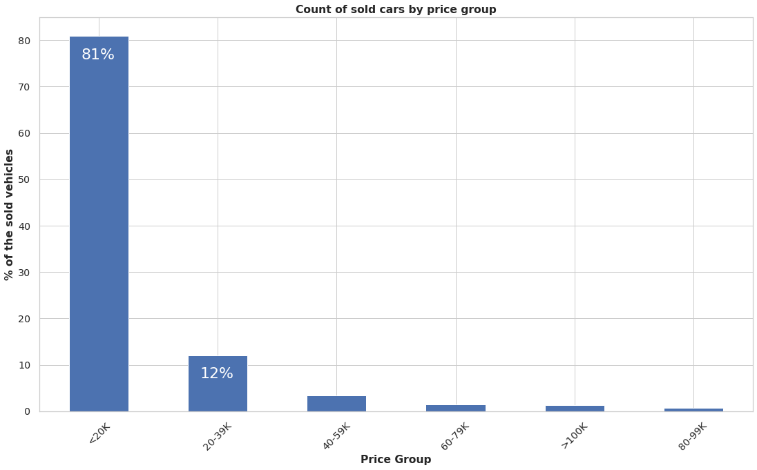
Which price range of cars sold the most of the car?
Approx 81% of cars sold in the price range of less than or equal to $20000.

Slide 13
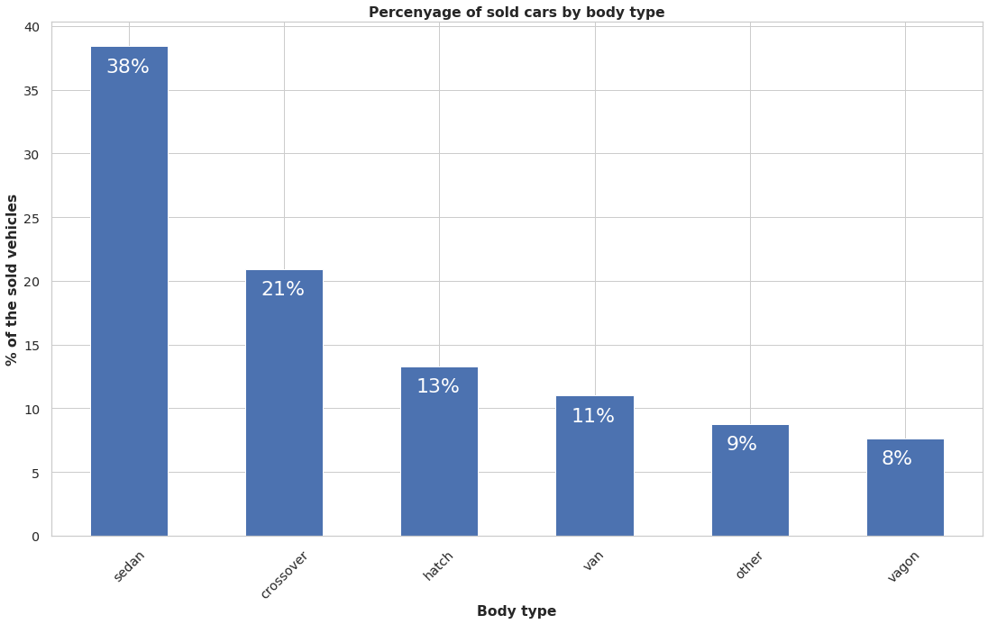
Which body type of cars sold the most of the car?
Sedan body type cars are the most sold cars.
We can say this in other terms that the most preferred choice for people is Sedan, because it is the perfect and comfortable car for small size family within lower budget.
Approx 38% of total cars sold in Sedan body type, 21% in Crossover body type and 13% in Hatch body type.
Sedan are most preferred private cars among public vehicles vans are preferred.

Slide 14
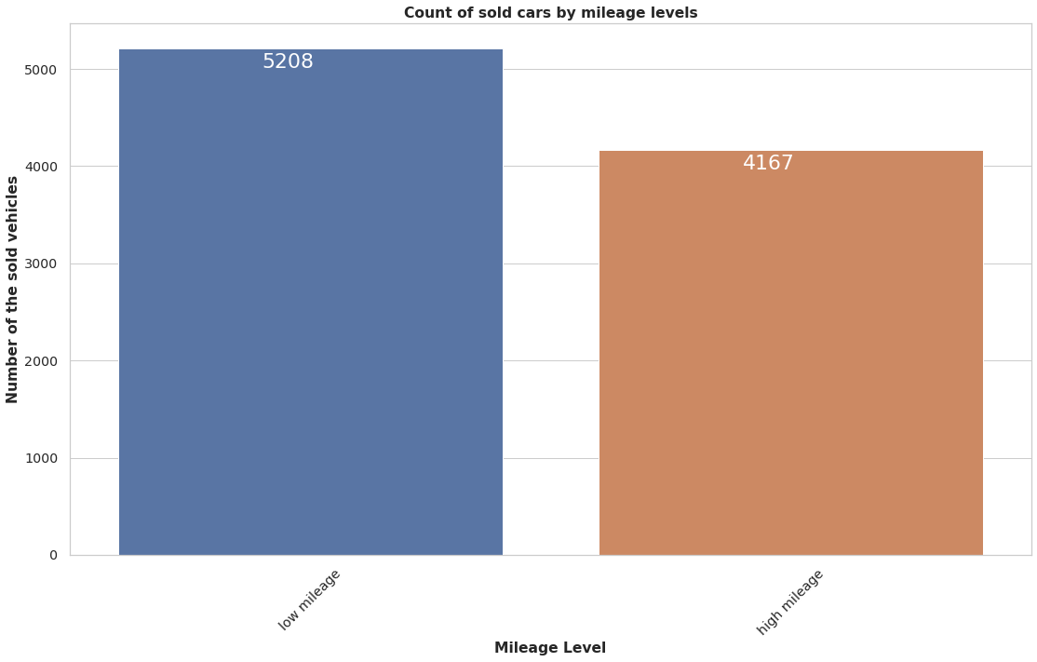
What is variation of the car sold in terms of mileage of the car?
Low mileage vehicles are prefered.

Slide 15
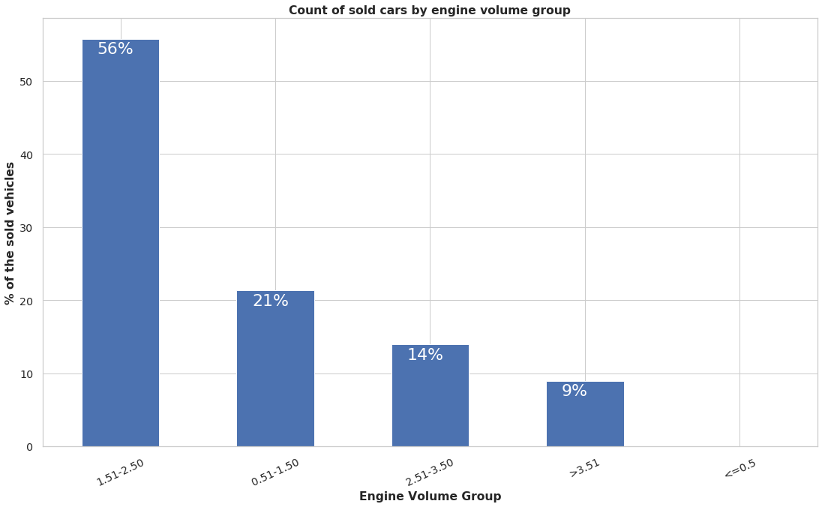
Which engine volume cars sold the most of the car?
Below are the top three categories of Engine Volume (engV) cars sold.
Ist Category : > 1.5 & <= 2.5 (In this category approx 56% of cars are available)
IInd Category : > 0.5 & <= 1.5 (In this category approx 21% of cars are available)
IIIrd Category : > 2.5 & <= 3.5 (In this category approx 14% of cars are available)
Out of total cars sold, approx 91% cars fall in range of engine volume more than 1.5 CC to 3.5 CC. Continued…….

Slide 16
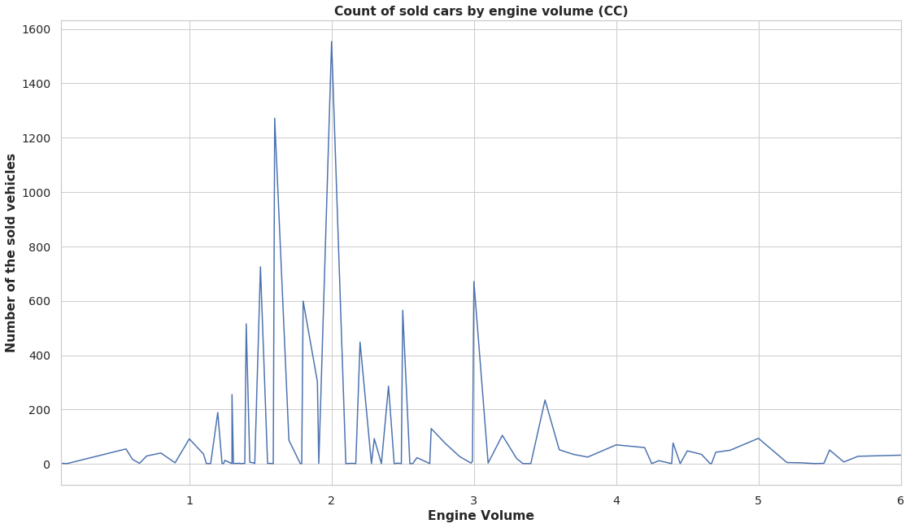
Which engine volume cars sold the most of the car?
Most of the cars sold have 2.0 CC engine volume followed by 1.5 CC, there are very few cars sold with engine volume less than equal to 1.0 CC and greater than equal to 4.0 CC.

Slide 17
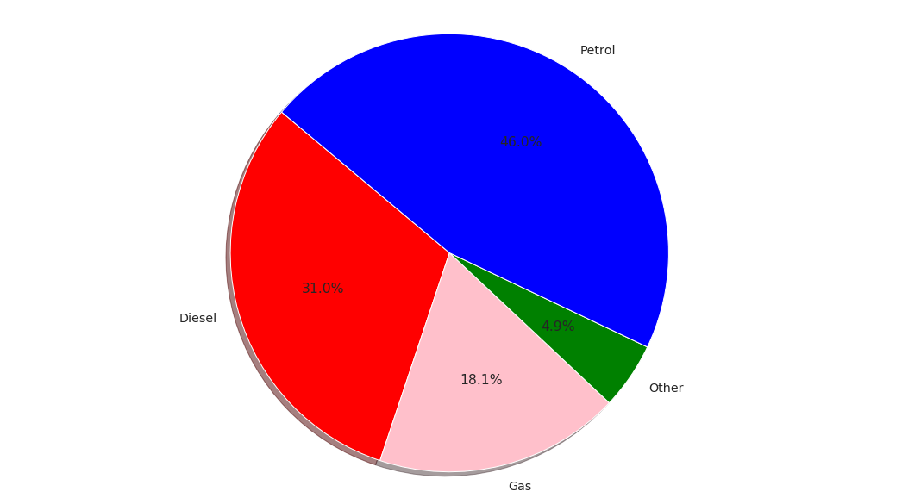
Which engine type cars sold the most of the car?
Petrol & Diesel cars are the most widely sold Engine Type. Gas and Other fuels are not so commonly used.

Slide 18
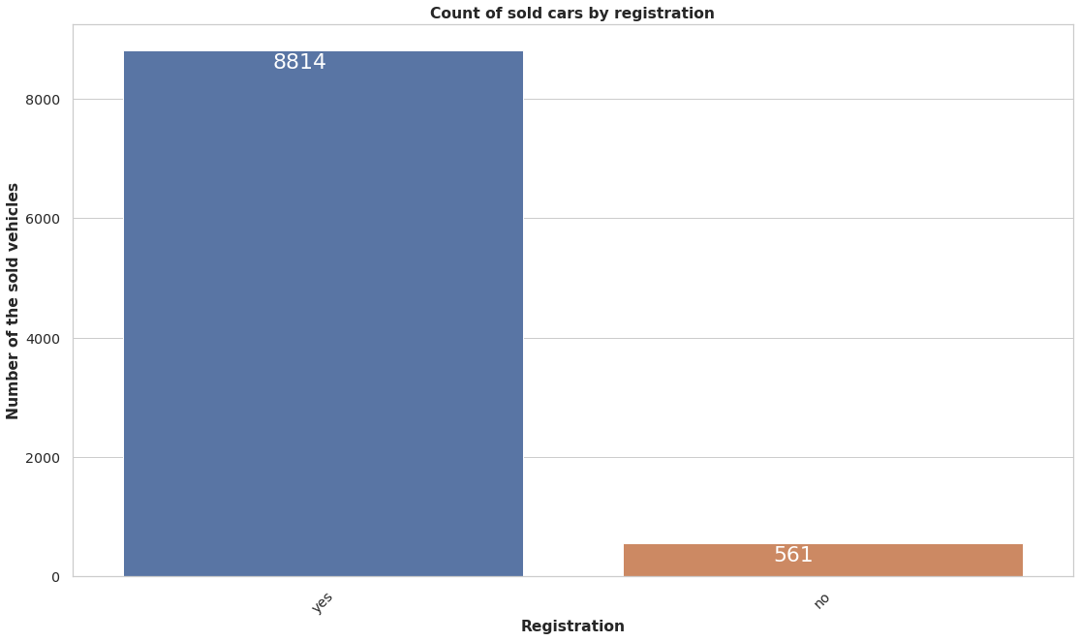
What is effect of the car sold in terms of registration of the car?
Registered vehicles are prefered.

Slide 19
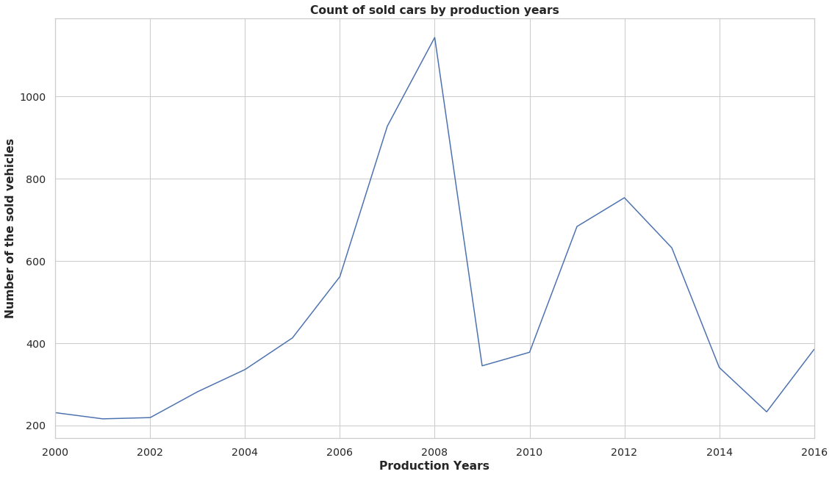
In which production year of cars sold the most of the car?
Production year 2008 and 2012 cars are sold the most. Year 2008 has the highest number of car sales record.

Slide 20
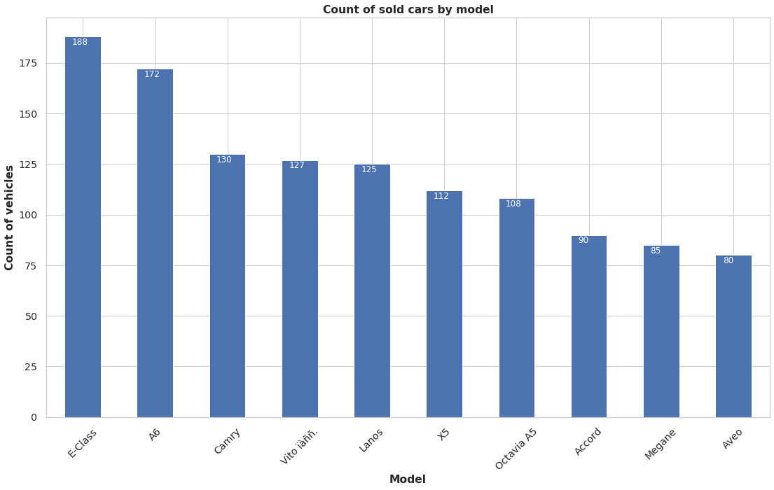
Which model type of cars sold the most of the car of the car?
E-Class car sold most.

Slide 21
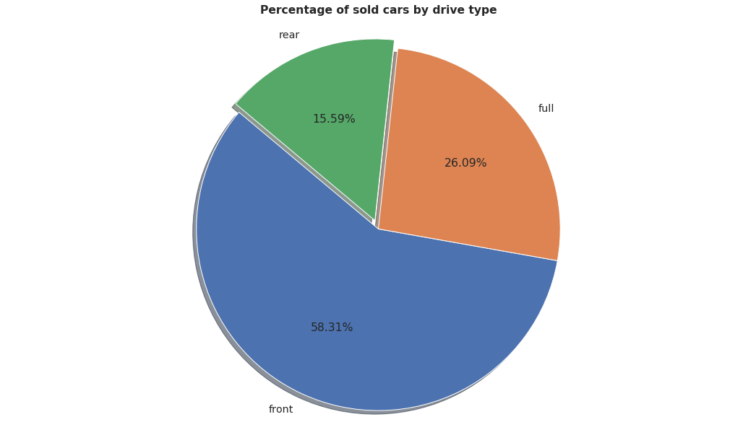
Which drive type of cars sold the most of the car?
Most sold cars in front drive type, in terms of percentage we can say that, approx 59% of total cars sold in front drive type, 26.09% in full drive type and 15.60% in rear drive type.

Slide 22
Bivariate Analysis

Slide 23
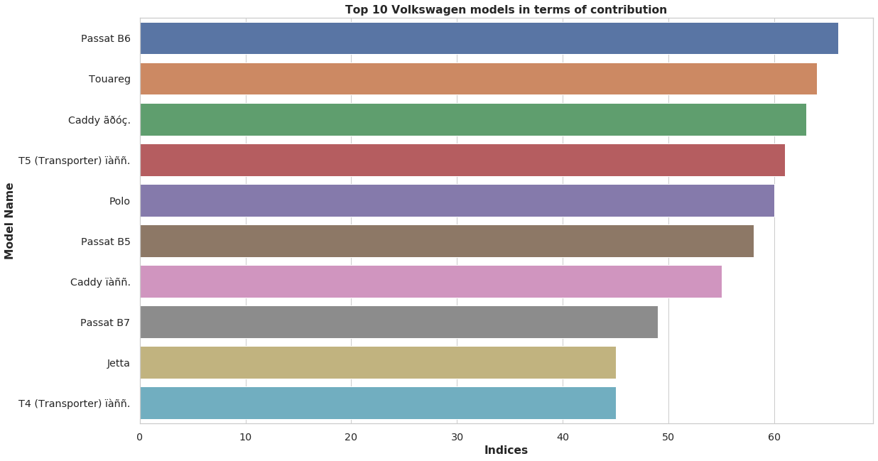
Which model is the most prefered in top brands of the car?
Continued...

Slide 24
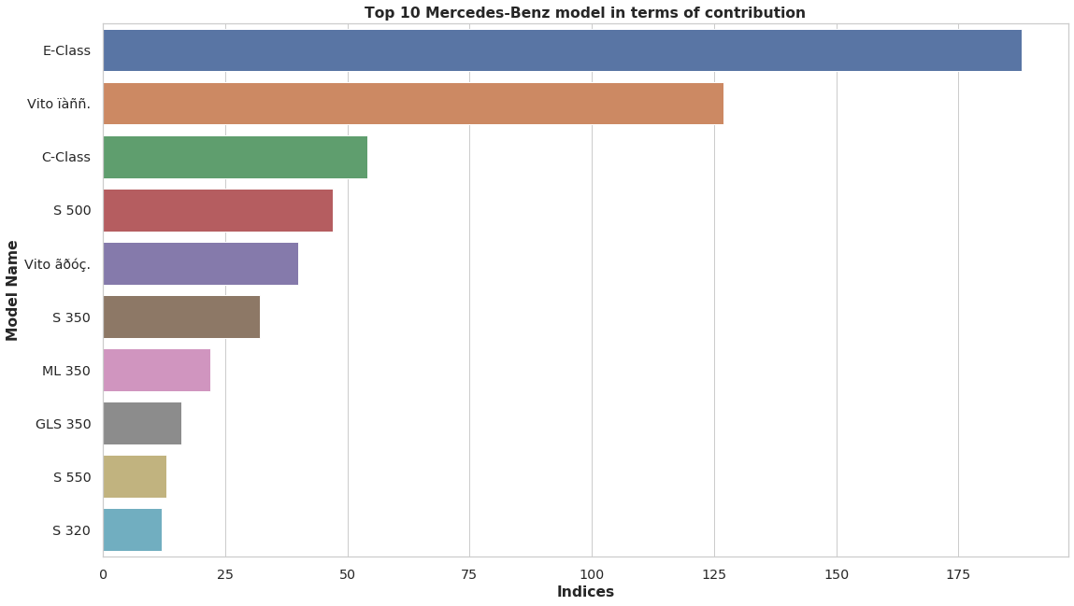
Passat & E-Class is the most prefered model in Volkswagen and Mercedes-Benz companies respectively.

Slide 25
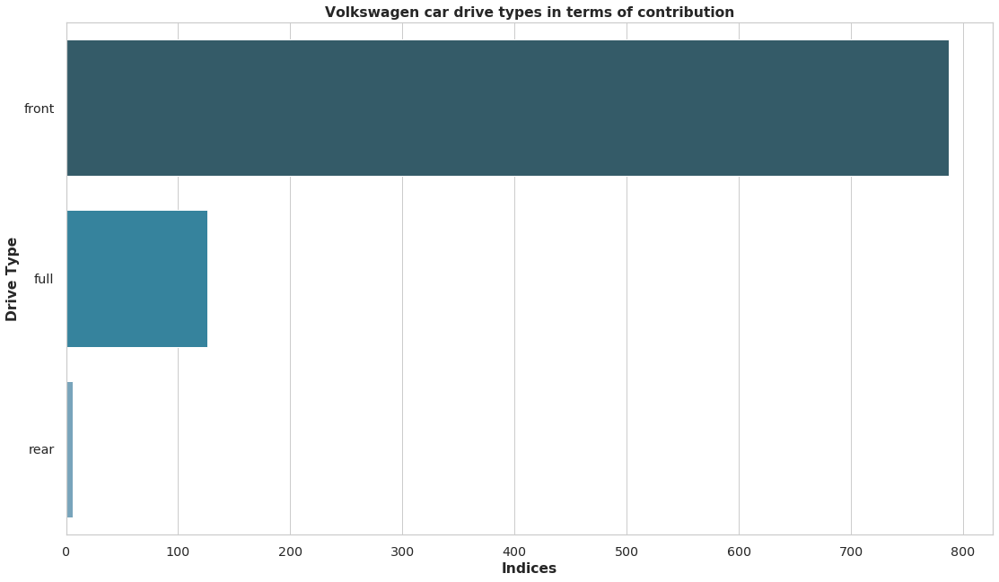
Which drive type is the most prefered in top brands of the car? Continued...

Slide 26
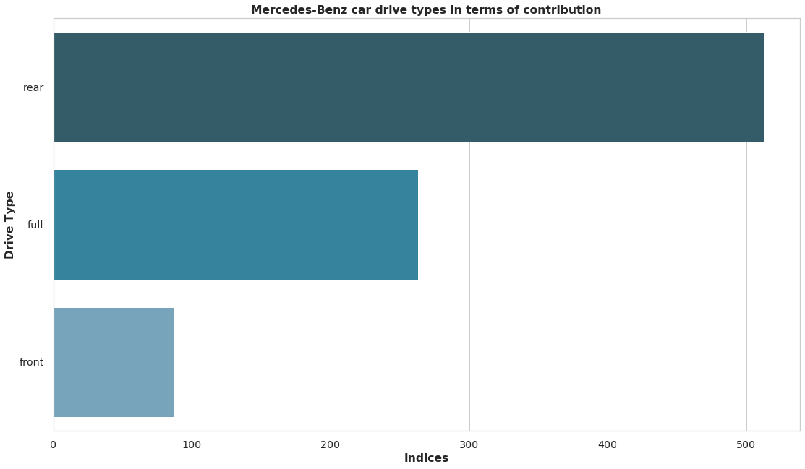
Front and rear drive is most preferred in Volkswagen and Mercedes-Benz companies respectively.

Slide 27
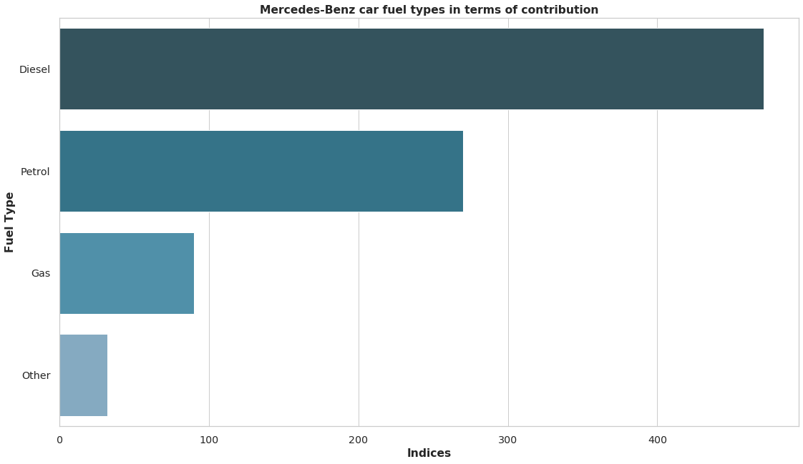
Which fuel type is the most prefered in top brands of the car? Continued...

Slide 28

Diesel engines are most preferred in Volkswagen and Mercedes-Benz car companies.

Slide 29
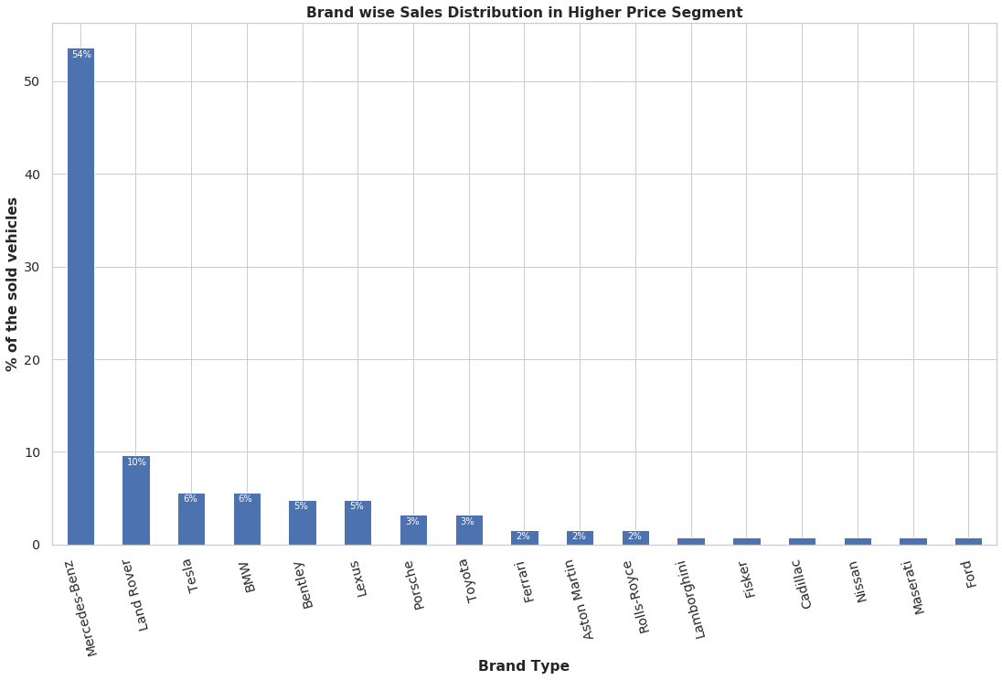
Average price of vehicle by brands?
Mercedes-Benz is the leading brand in higher price segment cars.

Slide 30
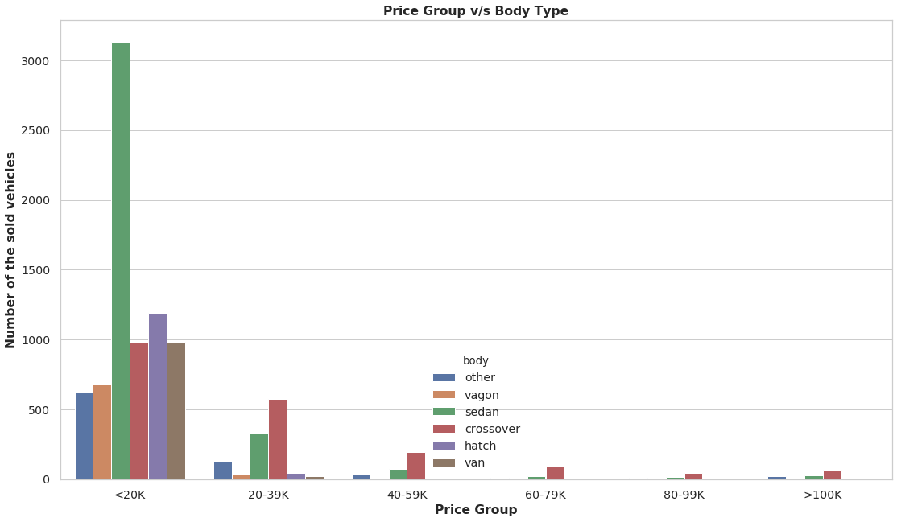
Average price of vehicle by body type?
The most cars sold in price range of less than 20000 and majority of these are in Sedan body type.
The majority is Crossover body type in Cars sold at a price 20000 or above.

Slide 31
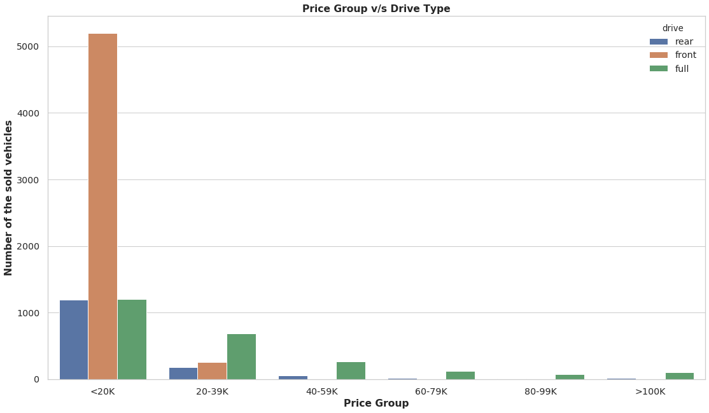
Average price of vehicle by drive type?
The most cars sold in price range of less than 20000 and majority of these are in Front drive type.
The majority is Full drive type in Cars sold at a price 20000 or above.

Slide 32
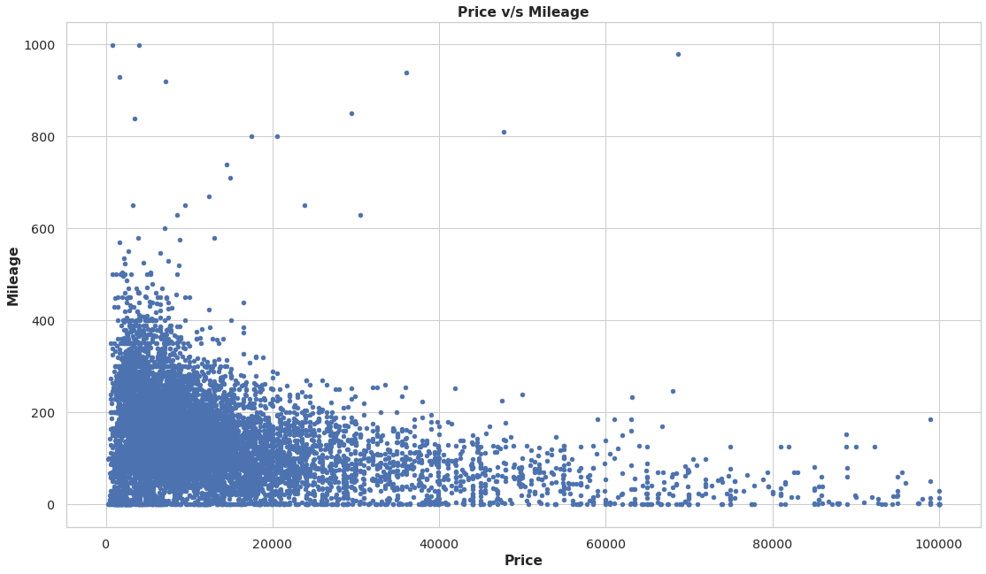
Average price of vehicle by mileage?
Price and mileage have strongly negative correlation in sold car dataset , i.e. lower price segment has higher mileage and higher price segment has lower mileage.

Slide 33
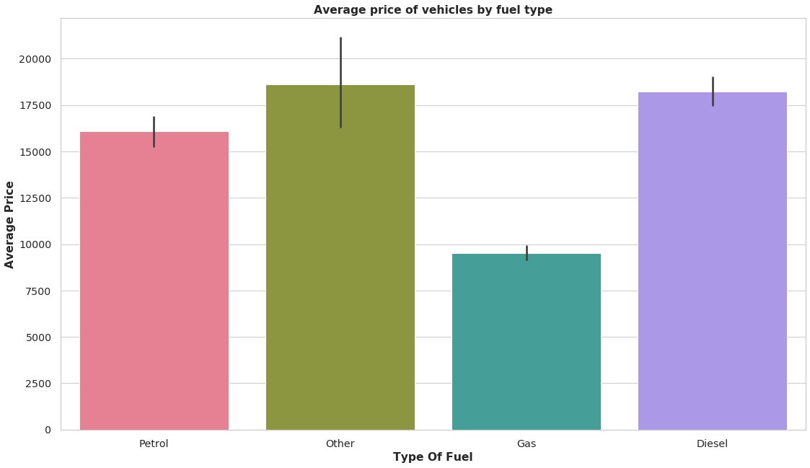
Average price of vehicle by fuel type?
Diesel vehicles are highly priced than Petrol and Gas.

Slide 34
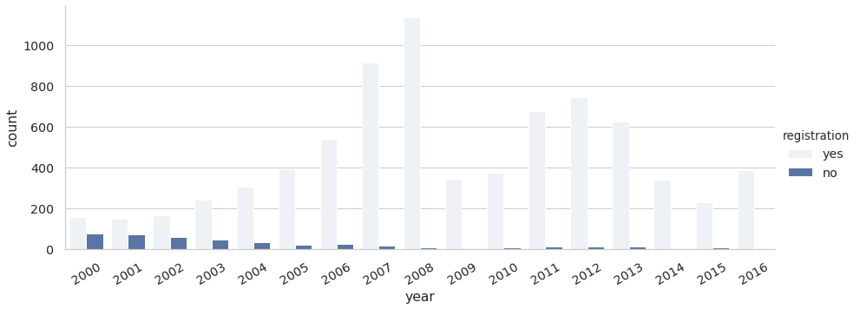
Most preferred registration mode over the years of the car?
Majority of the cars sold with production year 2008 or later were registered.

Slide 35
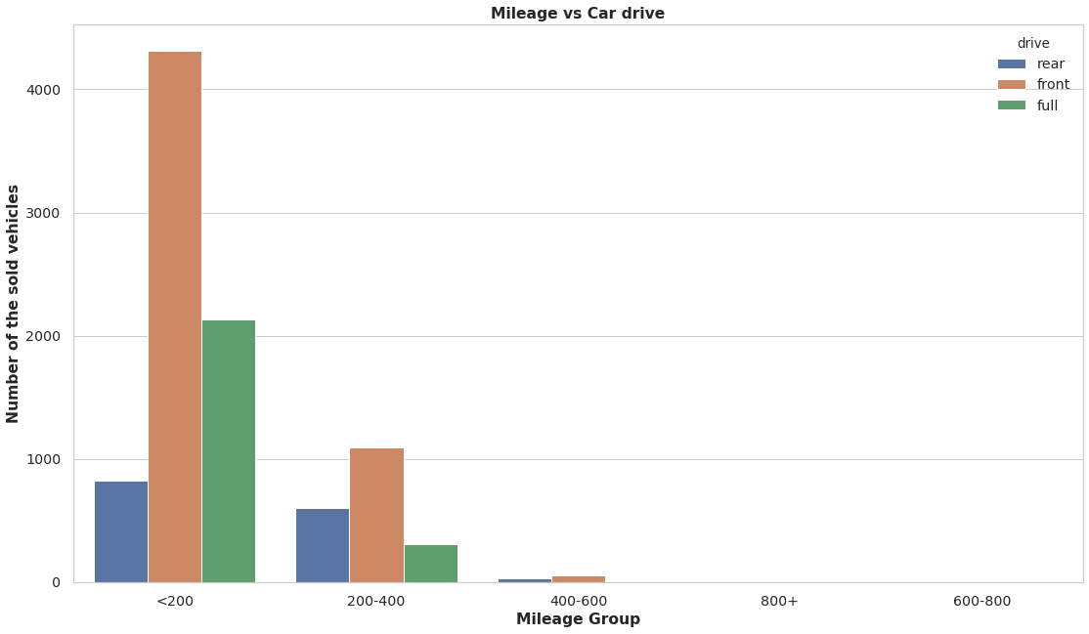
Most prefered drive type with mileage of the car?
Front drive cars are most prefered because of the high mileage they provide followed by Full drive car with very low mileage(<200).

Slide 36
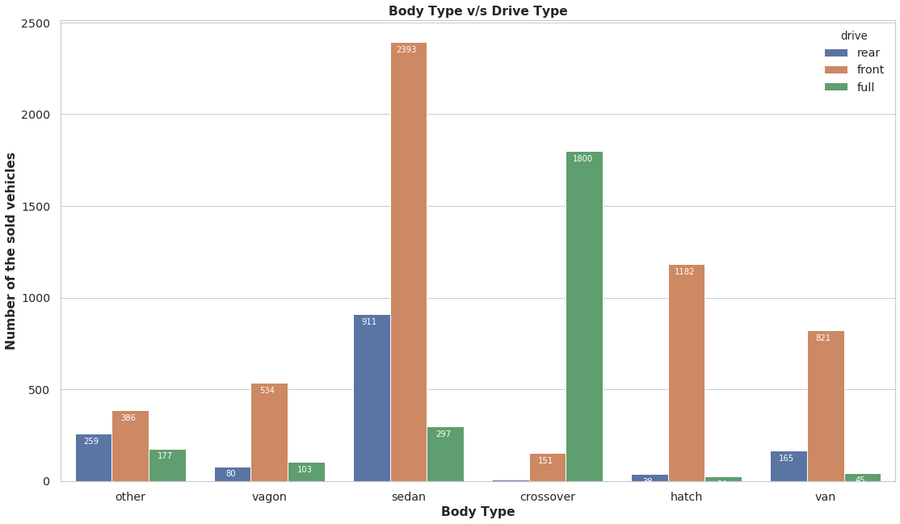
Most prefered drive type with body type of the car?
Front drive cars are the top most cars in all body type except in Crossover body type.
In Crossover body type Full drive cars are leading.

Slide 37
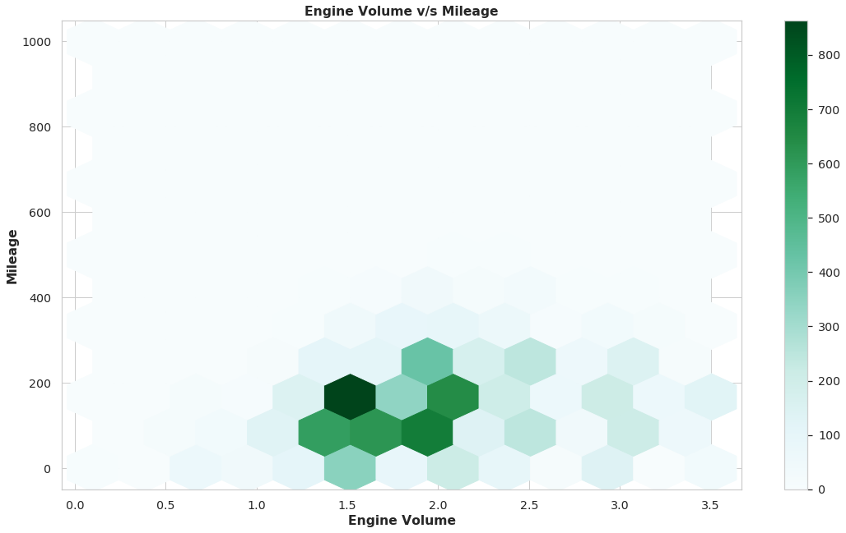
Most prefered engine volume with mileage of the car?
Most of the cars sold with engine volume (engV) as 1.5 CC and mileage as approx 200.

Slide 38
Multivariate Analysis

Slide 39
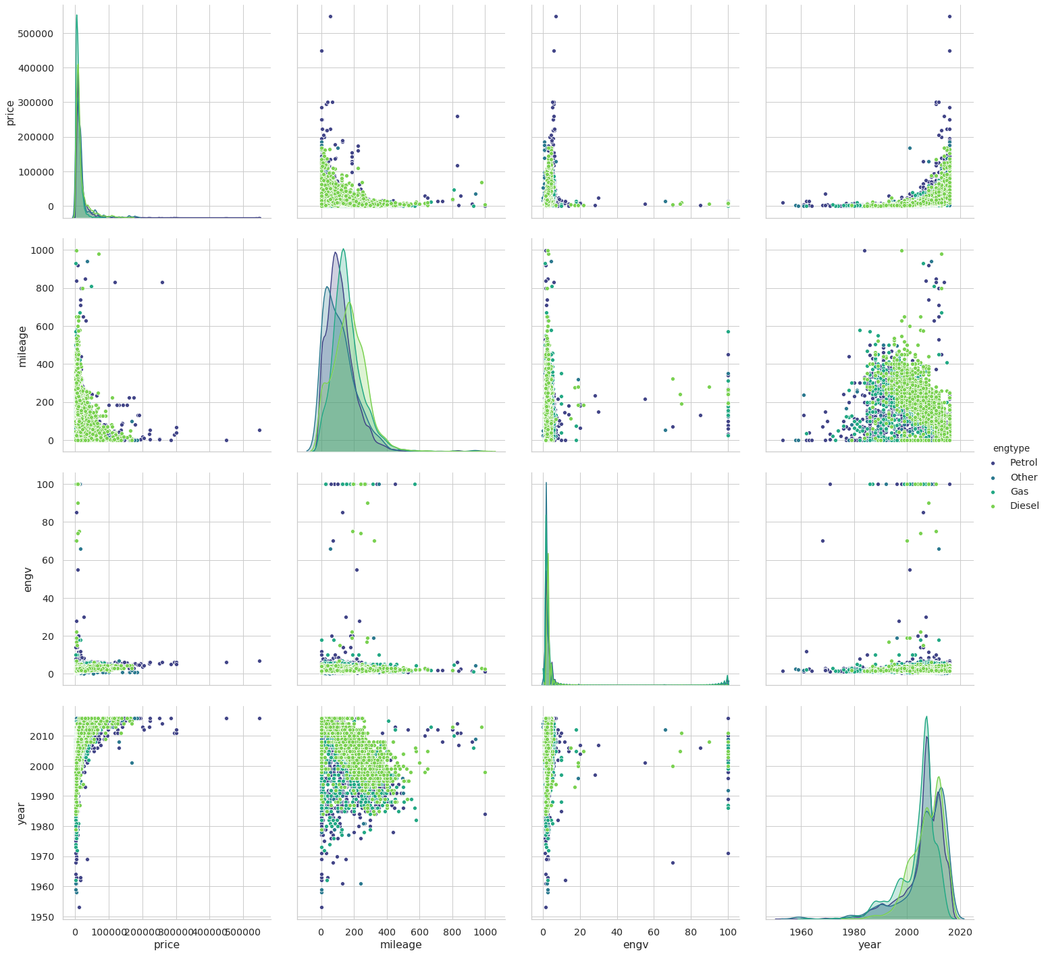
Pair Plot - What all variables paired with all the other variables of the car? Continued...

Slide 40
Price varying based on Year and Mileage
As Year increases there is increase in Petrol engine type vehicles prices which also depending on mileage too.
Majority of the cars with production year 2008 or later sold in price 50000 or lower.
All the cars with production year 2010 or later sold in price more than 50000.
All the cars with production year before 2010 sold in price 50000 or lower.
The most cars sold in price range of less than 20000 and majority of these are in Petrol engine type.
The majority is Diesel engine type in Cars sold at a price 20000 or above.
Mileage and price are indirectly related. high priced cars give low mileage.

Slide 41
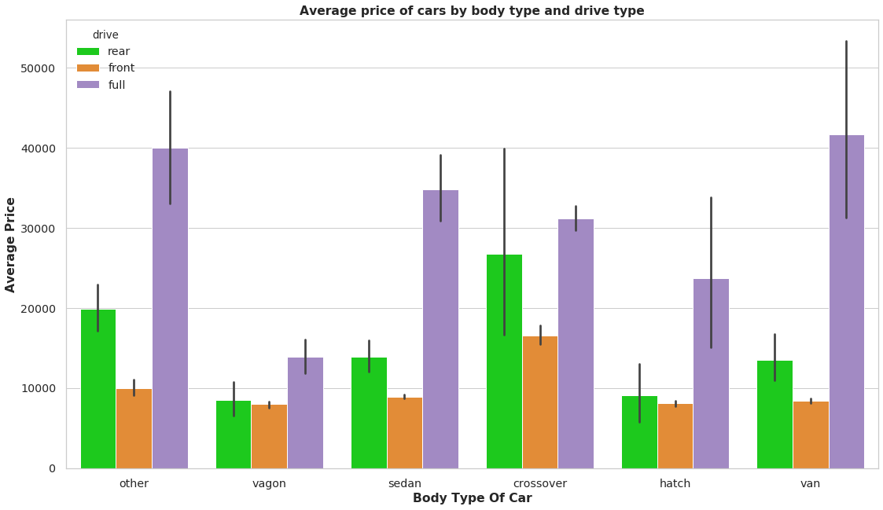
Average price of vehicle by body type and drive type of the car?
All body types of cars have more average price for full drive type cars compare to other drive types.

Slide 42
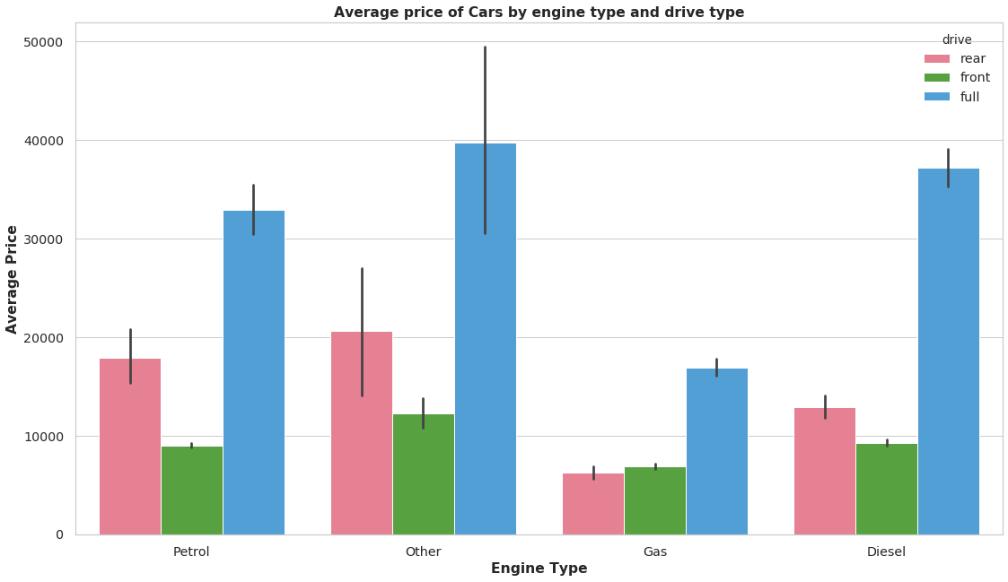
Average price of vehicle by engine type and drive type of the car?
The cars sold in all engine type have more average price for full drive type cars compare to other drive type cars.

Slide 43
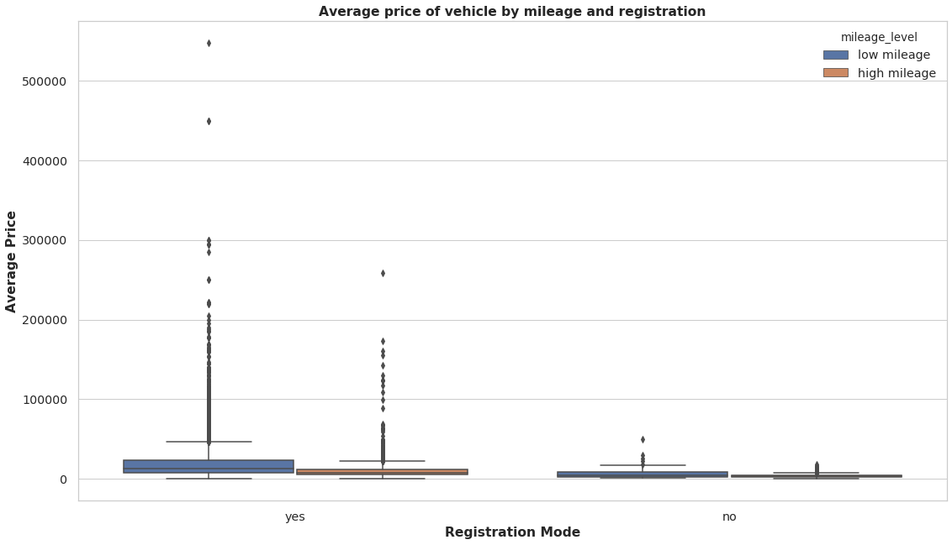
Average price of vehicle by mileage and registration of the car?
High mileage cars are low priced and vise-versa.

Slide 44
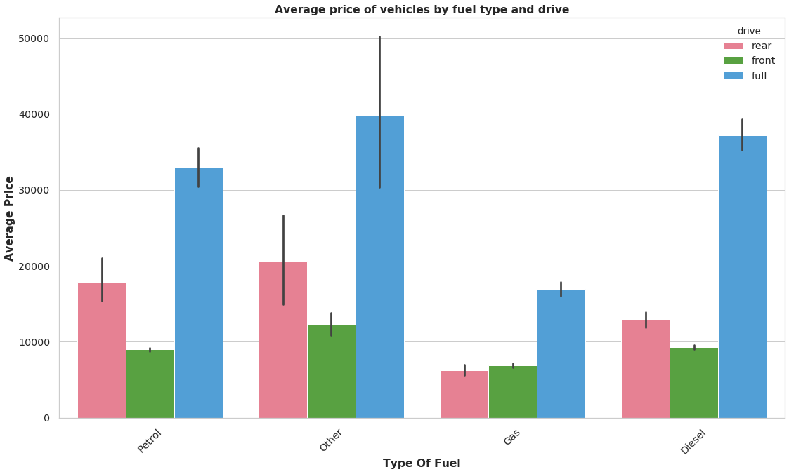
Average price of vehicle by vehicles by fuel type and drive?
Full drive cars of all engine type cars are high priced compared to other fuel types followed by the Rear drive cars in all fuel types.
In Petrol and Diesel Front drive cars are almost equally priced.

Slide 45
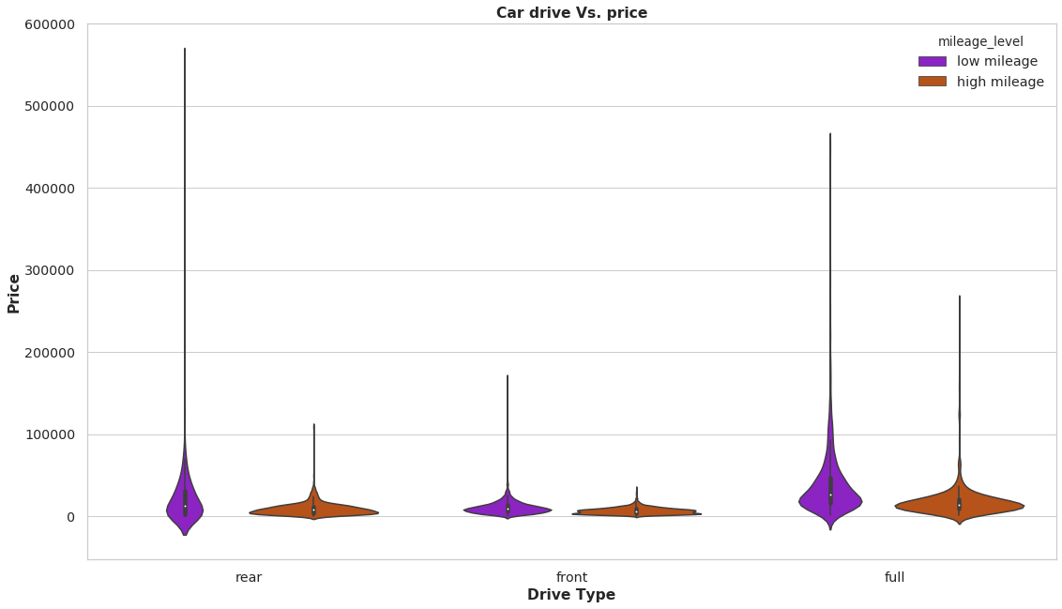
Average price of vehicle by mileage and drive of the car?
In all the car drive types, low mileage car are highly priced. where as the high mileage cars are priced low.

Slide 46
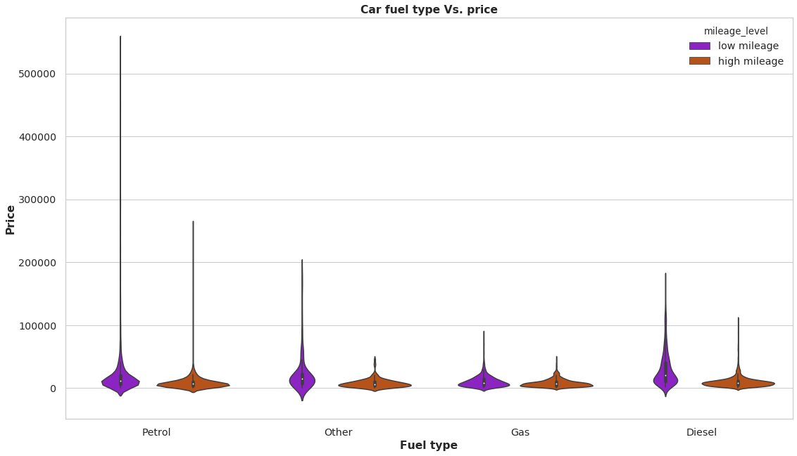
Average price of vehicle by mileage and fuel type of the car?
In all the fuel types, low mileage car are highly priced. where as the high mileage cars are priced low.

Slide 47
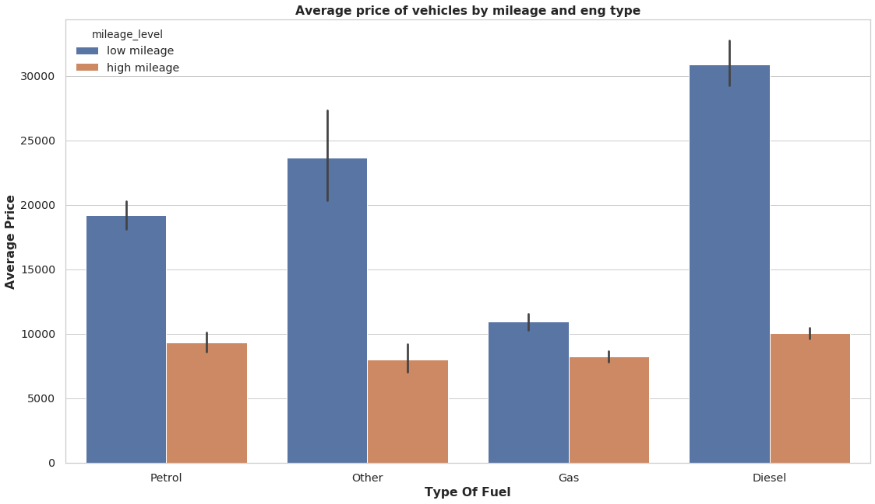
Average price of vehicles by mileage and eng type?
Diesel and Gas cars provide highest mileage followed by petrol cars, Diesel cars are highly priced with low mileage.

Slide 48
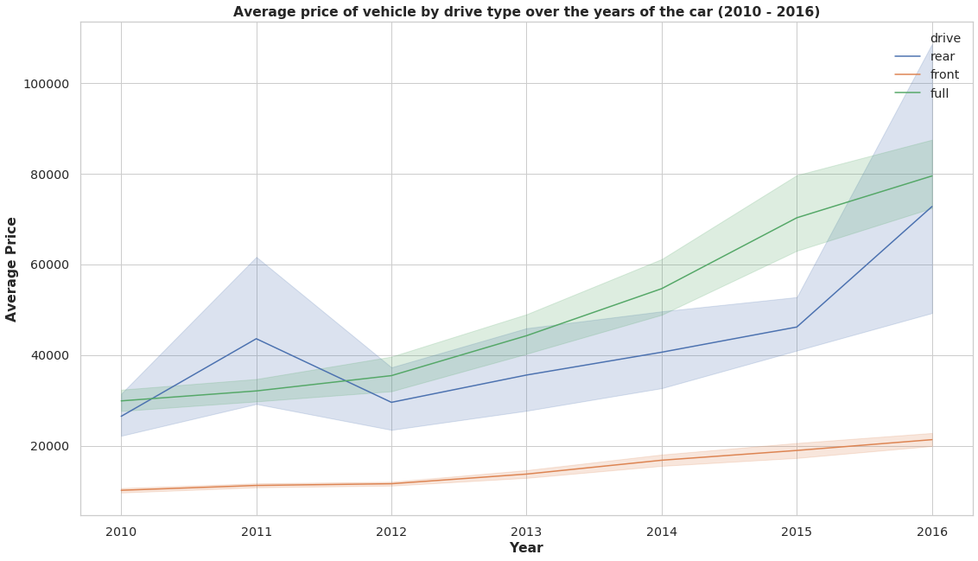
Average price of vehicle by drive type over the years of the car (2010 - 2016)?
As the years increase, we cannot comment on the price increase, but in general, there has been an increase in price in recent years.

Slide 49
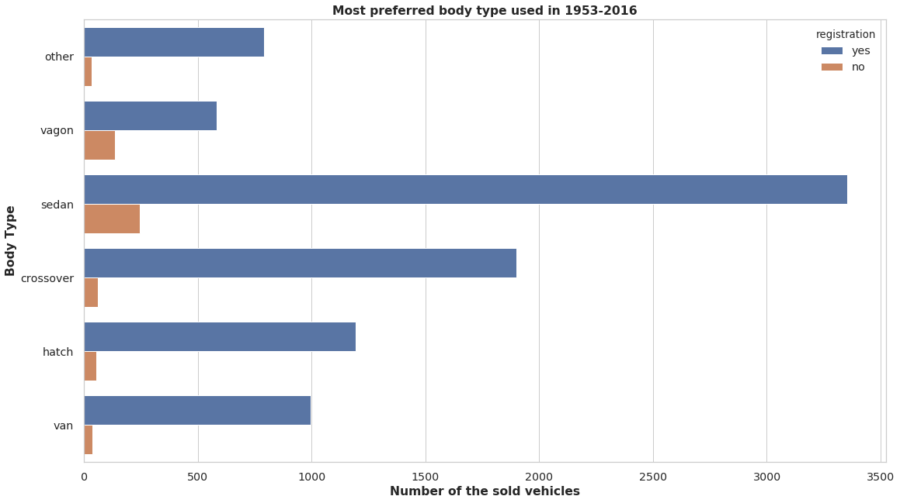
Most preferred body type used over the years of the car?
The car brands having Sedan type of body having maximum registration/sale over the years. This shows People prefers Sedan type of body mostly and hence this information can be use for achieving max sale and to figure out production of units.

Slide 50
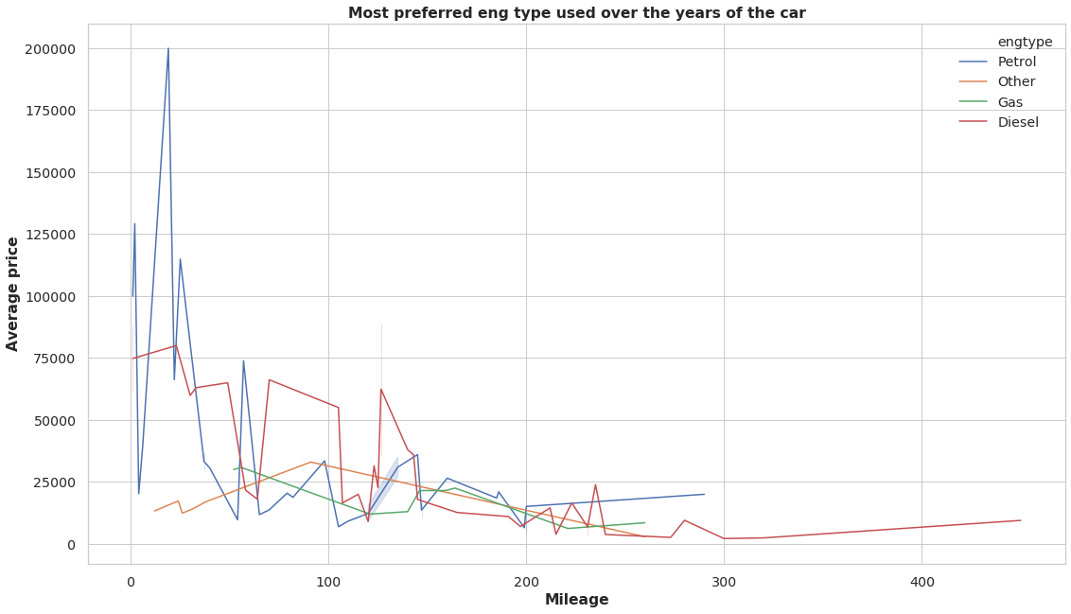
Most preferred eng type used over the years of the car?
Price changing accordingly based on mileage value. So price is varying based on mileage too and this should be considered a factor for the calculation.

Slide 51
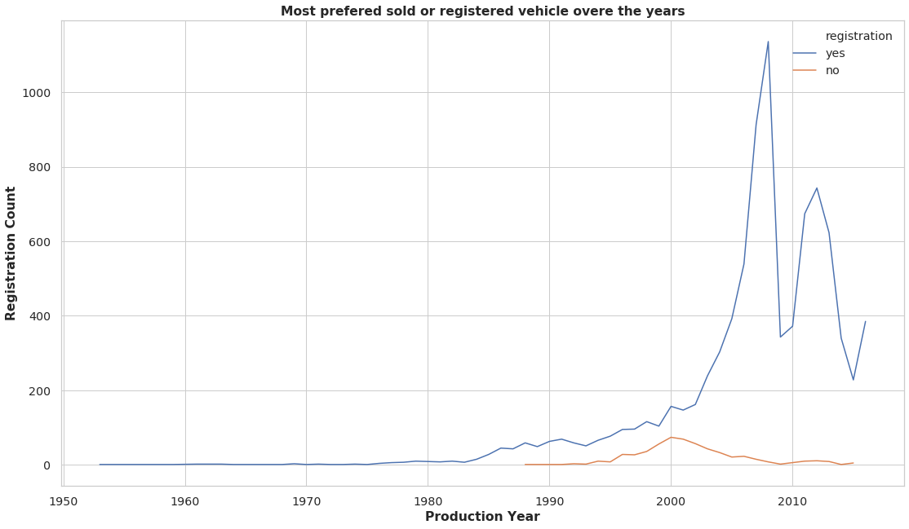
Most prefered sold or registered vehicle over the years?
Shows max sale was done in the Year 2008.

Slide 52
Conclusion
The most cars sold by the company Volkswagen followed by Mercedes-Benz and BMW.
Passat & E-Class is the most prefered model in Volkswagen and Mercedes-Benz companies respectively.
Front and rear drive is most preferred in Volkswagen and Mercedes-Benz companies respectively.
Diesel engines are most preferred in Volkswagen and Mercedes-Benz car companies.
Mercedes-Benz is the leading brand in higher price segment cars.
Approx 81% of cars sold in the price range of less than or equal to $20000 and majority of these are in Sedan body type with Front drive type.
The majority is Crossover body type in Cars sold at price between 20000 or above.
The majority is Full drive type in Cars sold at a price 20000 or above.
Diesel vehicles are highly priced than Petrol and Gas.
Price varying based on Year and Mileage
Continued…..

Slide 53
As Year increases there is increase in Petrol engine type vehicles prices which also depending on mileage too.
Majority of the cars with production year 2008 or later sold in price 50000 or lower.
All the cars with production year 2010 or later sold in price more than 50000.
All the cars with production year before 2010 sold in price 50000 or lower.
The most cars sold in price range of less than 20000 and majority of these are in Petrol engine type.
The majority is Diesel engine type in Cars sold at a price 20000 or above.
Mileage and price are indirectly related. high priced cars give low mileage.
High mileage cars are low priced and vise-versa.
Full drive cars of all engine type cars are high priced compared to other fuel types followed by the Rear drive cars in all fuel types.
In Petrol and Diesel Front drive cars are almost equally priced.
Diesel and Gas cars provide highest mileage followed by petrol cars, Diesel cars are highly priced with low mileage.
Continued…..

Slide 54
Approx 38% of total cars sold in Sedan body type, 21% in Crossover body type and 13% in Hatch body type.
Front drive cars are the top most cars in all body type except in Crossover body type.
In Crossover body type Full drive cars are leading.
The car brands having "sedan" type of body having maximum registration/sale over the years. This shows People prefers sedan type of body mostly and hence this information can be use for achieving max sale and to figure out production of units.
Low mileage vehicles are prefered.
Majority of the cars sold with production year 2008 or later were registered.
Front drive cars are most prefered because of the high mileage they provide followed by Full drive car with very low mileage(<200).
Most of the cars sold with engine volume (engV) as 1.5 CC and mileage as approx 200.
Continued…..

Slide 55
Out of total cars sold, approx 91% cars fall in range of engine volume more than 1.5 CC to 3.5 CC.
Most of the cars sold have 2.0 CC engine volume followed by 1.5 CC, there are very few cars sold with engine volume less than equal to 1.0 CC and greater than equal to 4.0 CC.
Petrol & Diesel cars are the most widely sold Engine Type. Gas and Other fuels are not so commonly used.
Registered vehicles are prefered.
Production year 2008 and 2012 cars are sold the most. Year 2008 has the highest number of car sales record.

Slide 56
Actionable Insights
Low mileage cars with high priced can be recommended for highly profiled customer.
Crossover body type is prefered in Full drive type thus the same experiment can be applied with Sadan.

